Slide 1
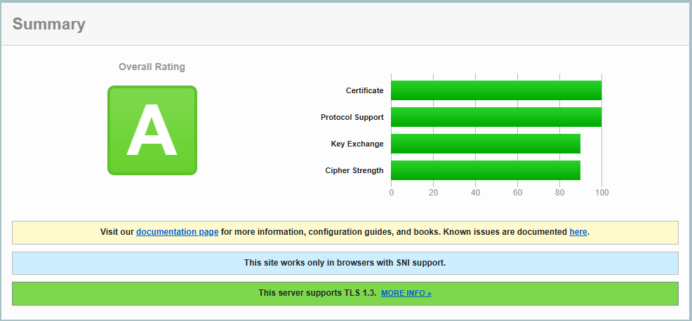
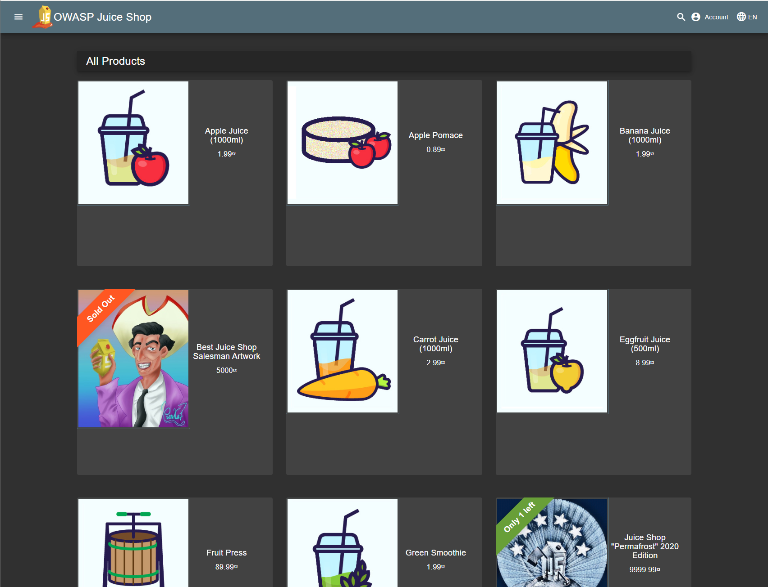
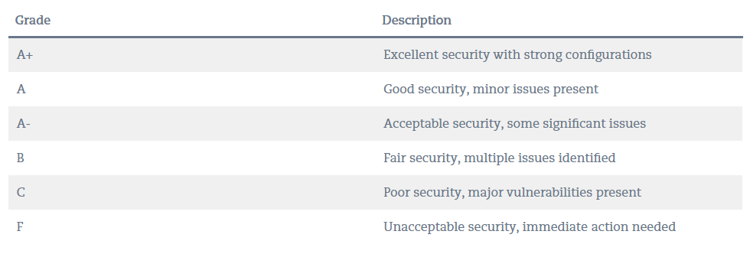
SSL Labs Report Analysis: demo.owasp-juice.shop
SSL Labs Report is a comprehensive analysis of an SSL/TLS server’s configuration. It evaluates how secure the site is, how well it follows industry standards, and what vulnerabilities or misconfigurations are present.
Sample Report:
https://www.ssllabs.com/ssltest/analyze.html?d=demo.owasp-juice.shop&s=81.169.145.156&hideResults=on

Slide 2
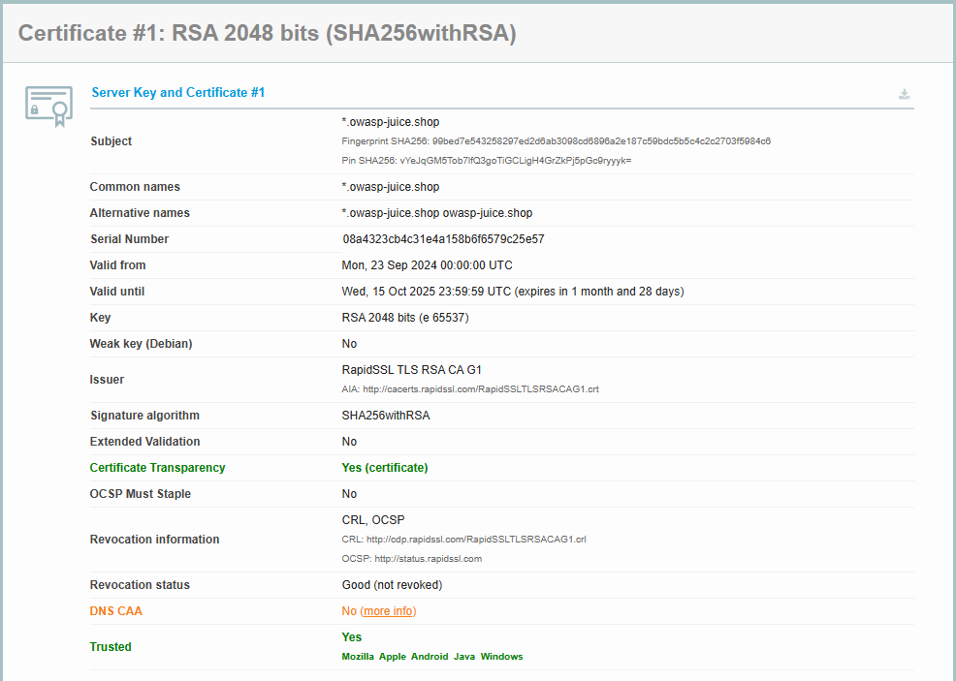
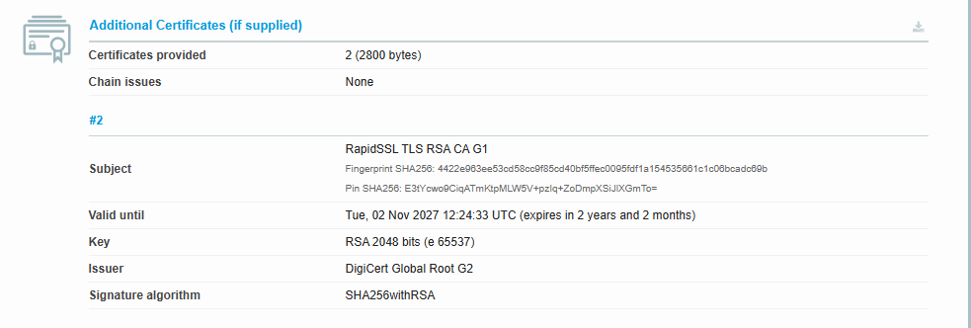
Certificate Properties
Subject: Identifies the certificate owner’s distinguished name (domain and organization info).
Common Names: Primary domain name the certificate is issued for.
Alternative Names: Additional domains covered by the same certificate (SANs).
Serial Number: Unique ID for the certificate assigned by the Certificate Authority.
Valid From: Date when the certificate becomes active.
Valid Until: Expiration date after which the certificate becomes invalid.
Key: Type and size of public key used (e.g., RSA 2048, ECDSA).
Weak Key (Debian): Detects if the key is affected by known Debian OpenSSL vulnerability.
Issuer: Name of the Certificate Authority that issued the certificate.
Signature Algorithm: Algorithm used to sign the certificate (e.g., SHA256withRSA).
Extended Validation: Indicates if the certificate has EV status for added trust (legal entity validation).
Certificate Transparency: Confirms if the cert is logged in public CT logs to detect mis issuance.
OCSP Must Staple: Requires stapled OCSP response for faster and reliable revocation checks.
Revocation Information: Provides links to check if the certificate is revoked (OCSP/CRL).
Revocation Status: Indicates whether the certificate is currently revoked or not.
DNS CAA: Restricts which CAs can issue certificates for the domain.
Trusted: Confirms if the certificate chain is trusted by browsers.

Slide 3
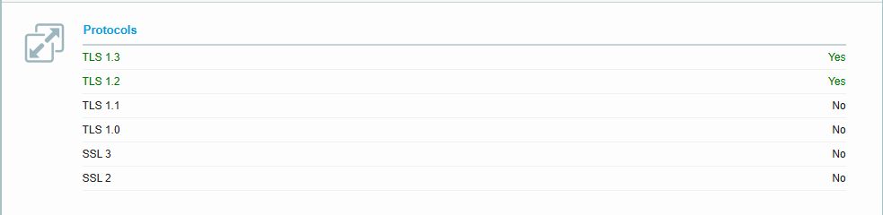
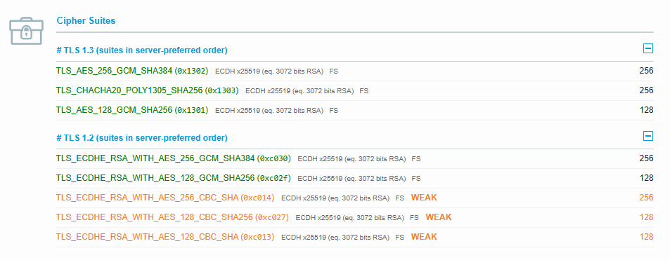
Protocols & Cipher Suites
Cipher Suite is set of algorithms used in an SSL/TLS connection:
Key Exchange: how the session key is shared (e.g., RSA, ECDHE).
Authentication: how the server (and sometimes client) proves its identity (e.g., RSA, ECDSA).
Encryption: how the data is scrambled so attackers can’t read it (e.g., AES, ChaCha20).
Integrity/Hashing: how to ensure data isn’t tampered with (e.g., SHA-256, Poly1305).
Example:
TLS_ECDHE_RSA_WITH_AES_256_GCM_SHA384
TLS: Protocol version
ECDHE: Key exchange (forward secrecy)
RSA: Authentication method
AES_256_GCM: Encryption algorithm + mode
SHA384: Integrity hash
Cipher Suites for TLS Protocols:
https://ciphersuite.info/cs/?tls=xtls13&singlepage=true&page=3&sort=sec-desc
SSL 2.0 / 3.0: Outdated and insecure protocols; must be disabled.
TLS 1.0 / 1.1: Weak and deprecated; vulnerable to known attacks (e.g., BEAST, POODLE).
TLS 1.2: Still widely used and secure when paired with strong ciphers.
TLS 1.3: Latest and most secure protocol with faster handshakes and modern encryption.

Slide 4
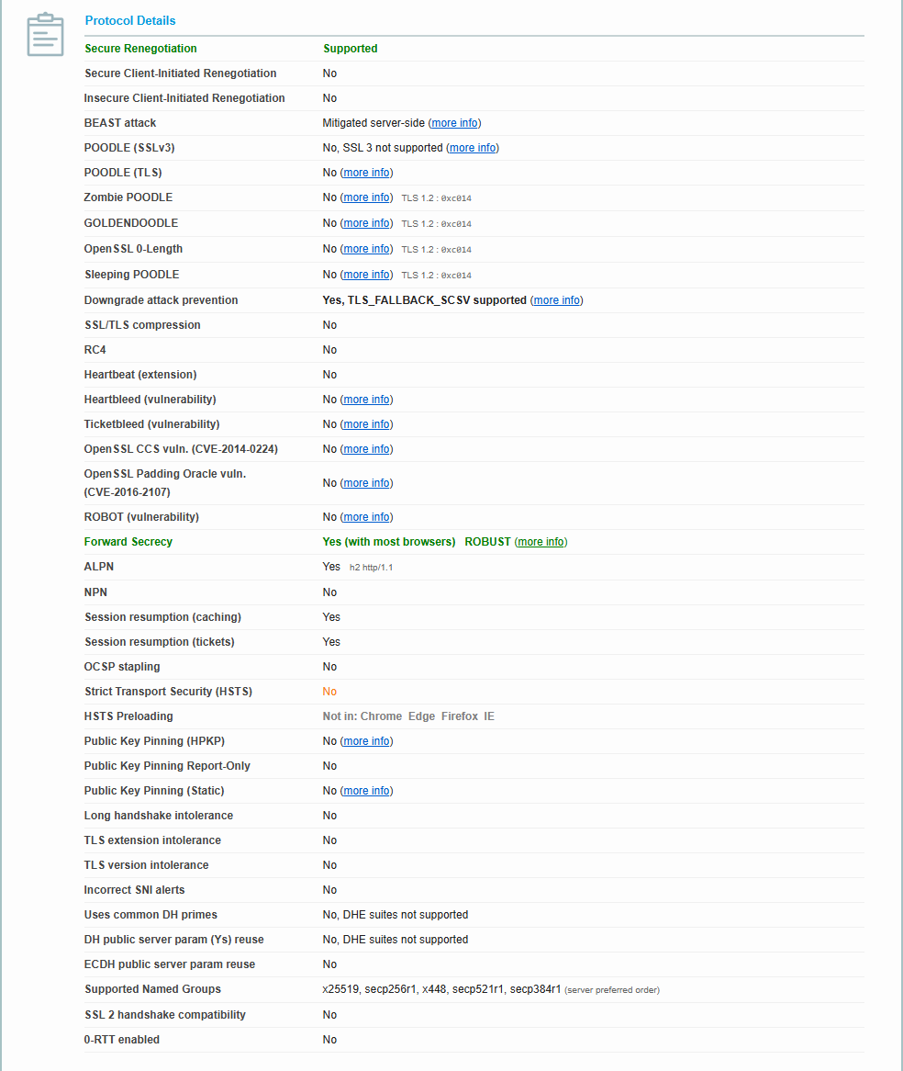
Protocol Details
Secure Renegotiation: Prevents man-in-the-middle during renegotiation; must be supported.
Secure Client-Initiated Renegotiation: Stops clients from forcing extra renegotiations; safe when disabled.
Insecure Client-Initiated Renegotiation: Legacy unsafe renegotiation; should always be disabled.
BEAST attack: Old TLS 1.0 flaw; safe if mitigated or TLS 1.0 disabled.
POODLE (SSLv3): Exploit of SSLv3; safe if SSLv3 disabled.
POODLE (TLS): Rare padding attack on TLS; should be blocked.
Zombie POODLE / GOLDENDOODLE / Sleeping POODLE: Variants of TLS padding attacks; safe if modern ciphers used.
OpenSSL 0-Length: Exploit of empty fragments; safe if patched.
Downgrade attack prevention: TLS_FALLBACK_SCSV prevents forced downgrade; must be enabled.
SSL/TLS compression: Disables CRIME attack risk; must be off.
RC4: Insecure cipher; must be disabled.
Heartbeat (extension): Needed only for keepalive; disabled avoids Heartbleed risk.
Heartbleed (Vulnerability): OpenSSL memory leak bug; safe if patched.
Ticketbleed (Vulnerability): Session ticket bug; safe if patched.
OpenSSL CCS vuln. (CVE-2014-0224): Critical OpenSSL flaw; safe if patched.
OpenSSL Padding Oracle vuln. (CVE-2016-2107): Padding check bug; safe if patched.
ROBOT (Vulnerability): Old RSA padding attack; safe if RSA not vulnerable.
Forward Secrecy: Ensures past sessions stay safe if keys are stolen; must be enabled.

Slide 5
Protocol Details
ALPN: Lets server pick HTTP/2 or HTTP/1.1; modern and required.
NPN: Old protocol negotiation method; should be off.
Session resumption (caching): Improves performance by reusing sessions.
Session resumption (tickets): Fast reconnects using session tickets.
OCSP stapling: Speeds up certificate revocation checks; recommended.
Strict Transport Security (HSTS): Forces HTTPS use by browsers; should be enabled.
HSTS Preloading: Hard-codes HTTPS enforcement in browsers; increases safety.
Public Key Pinning (HPKP): Deprecated pinning mechanism; now avoided.
Long handshake intolerance: Checks for handshake failures; none means safe.
TLS extension intolerance: Tests if server rejects TLS extensions; none is safe.
TLS version intolerance: Tests if server rejects newer versions; none is safe.
Incorrect SNI alerts: Warns of SNI mismatch; none means safe.
Uses common DH primes: Weak shared parameters in DH; avoided if not supported.
DH public server param reuse: Reusing DH keys weakens secrecy; must not be reused.
ECDH public server param reuse: Same check for ECDH; must not be reused.
Supported Named Groups: Lists elliptic curves supported (x25519, P-256, etc.).
SSL 2 handshake compatibility: Legacy SSL2 handshake; must be off.
0-RTT enabled: TLS 1.3 early data; fast but replays possible; safe if off.

